Slide 1

Engagement
Paula Bibbs-Samuels, MS, LPC

Slide 2
Goals
To understand the difference between hearing and listening
Engagement & Buy-In
To draw attention to biases
To share my story, means to share myself
Listen

Slide 3

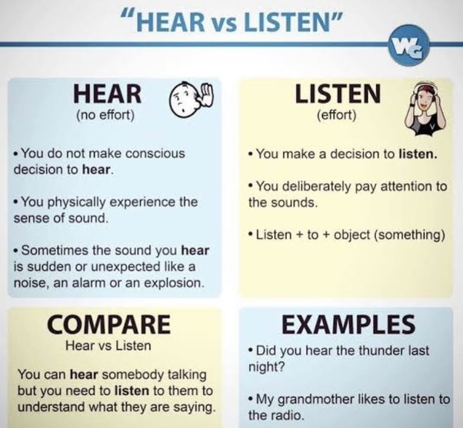
Hear vs listen

Slide 4
Listen Up
First-hand experience is often considered a better qualification than just being formally educated.
Parents, families, and caregivers have this first-hand experience, so who better to speak up about the child welfare system than them?
Who most likely knows their child best?
Who can share the different supports and strengths of the family?
Who is more likely to give an honest critique of the child welfare system?

Slide 5
Listen Up
Engagement
Involvement
Togetherness
Joint effort
Buy-In
Acceptance
Willingness to actively support

Slide 6
Engagement
Early
Give space for family, parent, and caregiver voice
Create comfortable feedback loops
Connect families with peer supports

Slide 7
Engagement
FATHERS

Slide 8
Engagement
Engage families in case planning
Engage families in child placement
Engage family members
Engage community members

Slide 9
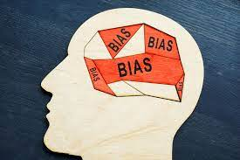
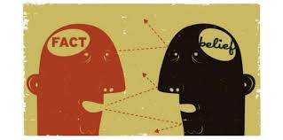
Biases

Slide 10
Biases
Explicit | Implicit
Racism | Racial Profiling
Prejudice | Affinity bias – favoring those similar
Discrimination

Slide 11
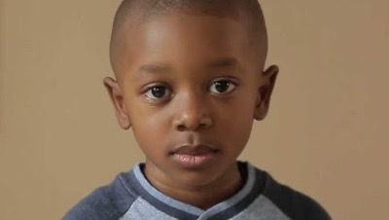
Biases

Slide 12
Ways to reduce implicit bias
Intentionally interact with those from diverse backgrounds
Counter-stereotyping – exposure to factual information that counters the stereotype
Be honest with yourself
Evaluate your actions, attitudes, and behaviors
Take bias training

Slide 13
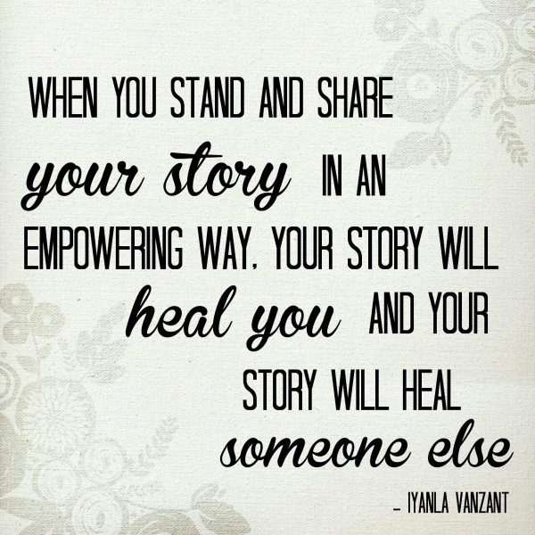
To share my story, means to share myself

Slide 14
Safety
Well-Being
Permanency

Slide 15
Commit to Listen
Slow Down
Stay focused
Don’t interrupt
Be aware of biases
Don’t force personal opinions or solutions
Engage all parties
Ask Questions

Slide 16
Resources
Engaging Families in Permanency Planning: https://www.childwelfare.gov/topics/permanency/planning/engaging-families/
Implicit Bias in the Child Welfare, Education, and Mental Health Systems: https://ncwwi.org/files/Cultural_Responsiveness__Disproportionality/Implicit-Bias-in-Child-Welfare-Education-and-Mental-Health-Systems-Literature-Review_061915.pdf
Race and Poverty Bias in the Child Welfare System: Strategies for Child Welfare Practitioners: https://www.americanbar.org/groups/public_interest/child_law/resources/child_law_practiceonline/january---december-2019/race-and-poverty-bias-in-the-child-welfare-system---strategies-f/
Strategies for Reducing Inequity: Addressing Bias: https://www.childwelfare.gov/topics/systemwide/cultural/disproportionality/reducing/bias/
Working With Children, Youth, and Families in Permanency Planning: https://www.childwelfare.gov/topics/permanency/planning/

Slide 17
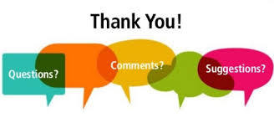
Questions/Comments

Slide 18

Contact:
Paula Bibbs-Samuels, MS, LPC
806.828.0097
PK3BKKH@gmail.com

