Slide 1





Connected Communities -
Thriving Families
Statewide Convening May 30, 2024
Stoney Creek Inn | Columbia, Missouri

Slide 2

CC-TF Vision
Our Hope for the Future
  We envision a Missouri where all children and families reach their potential in safe, healthy communities.
Our Core Belief: Why We Do It
  We believe in developing the potential of Missouri children and families every day.
Our Promises: How We Do It
  Support families with the right service at the right time to ensure health, safety and well-being.
  Partner with communities to advance and support priorities.
  Lead innovation and quality through professional learning communities, data analysis and reporting.

Slide 3


Promote prevention.
Advancing Thriving Families & Communities
Advance equity for all.
Purposefully engage those with lived expertise.
Remain resolute to advancing policies that support children, family and community well-being.

Slide 4

Missouri spent
$592
million
on child welfare in 2022.
$131 million was on out-of-home care.
$131
Missouri’s Child Welfare Agency has become the default system for families and children experiencing challenges and/or crisis.

Slide 5
Families belong together.
Believe
We
Poverty should not be a reason to separate families.
All children and families have strengths.

Slide 6
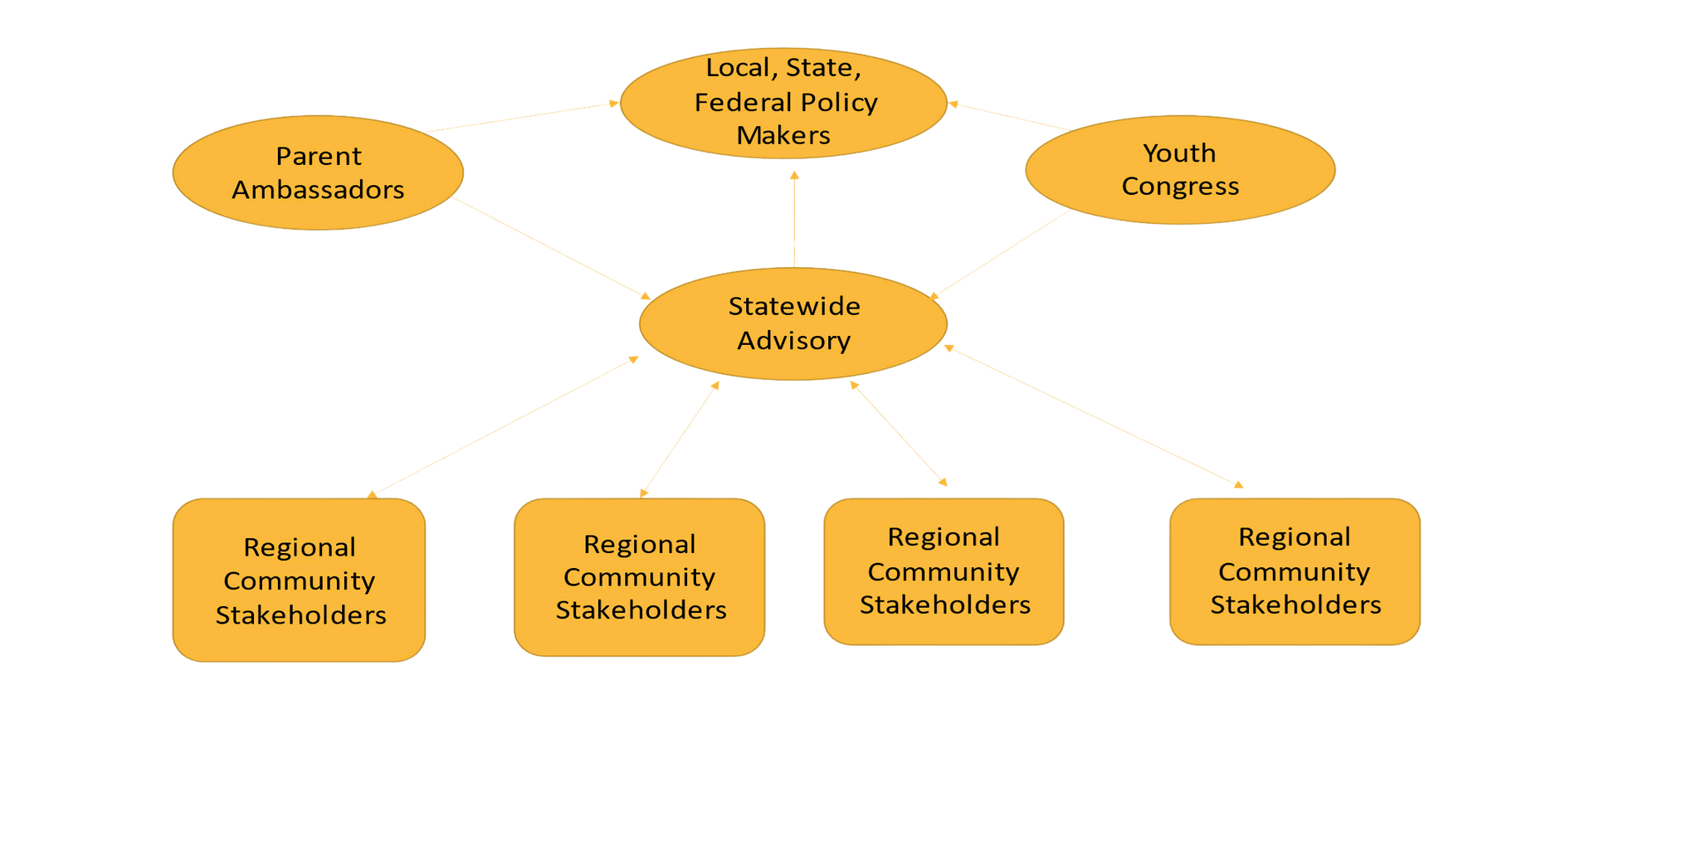

Our Approach

Slide 7







What Does That Mean?
Co-design solutions with communities
Align policies, statutes and resourcing from community-identified solutions
Engage supports to help overloaded families
Remove barriers to access services
Ex: transportation, hours of access, separation from children to participate, child care, location, cultural insensitivity

Slide 8
Our Journey
Statewide Champions
Parent Ambassadors
Our Communities
  St. Louis
  Kansas City
  Northeast (Kirksville)
  Southeast (Sikeston)
  Southwest (Springfield/Joplin)
Legal Representation
Youth
Congress
State Policy, Practice and Funding

Slide 9

Lessons Learned Through Listening
  Parents and youth seek relationships and connections as well as supports, resources and services.
  Communities would benefit from mandated supporters, not just mandated reporters.
  Availability of services does not equate to access of services.
  Conditions of poverty are not neglect.

Slide 10




Ask and listen to families about what they need.
Goals
CC-TF
Eliminate financial barriers for families to actively participate in reunification.
Increase access and availability of prevention/family support services.
Provide legal representation to parents.

Slide 11

Progress Toward Goals
  Utilize Title IV-E funding to support legal representation for parents.
  Distribute federal benefits to youth in care.
  Waiver of child support collection for children in state custody.
  Leveraging housing vouchers for transition youth.
  Replicate parent-peer support models.
  Establish Family Connection Centers.

Slide 12
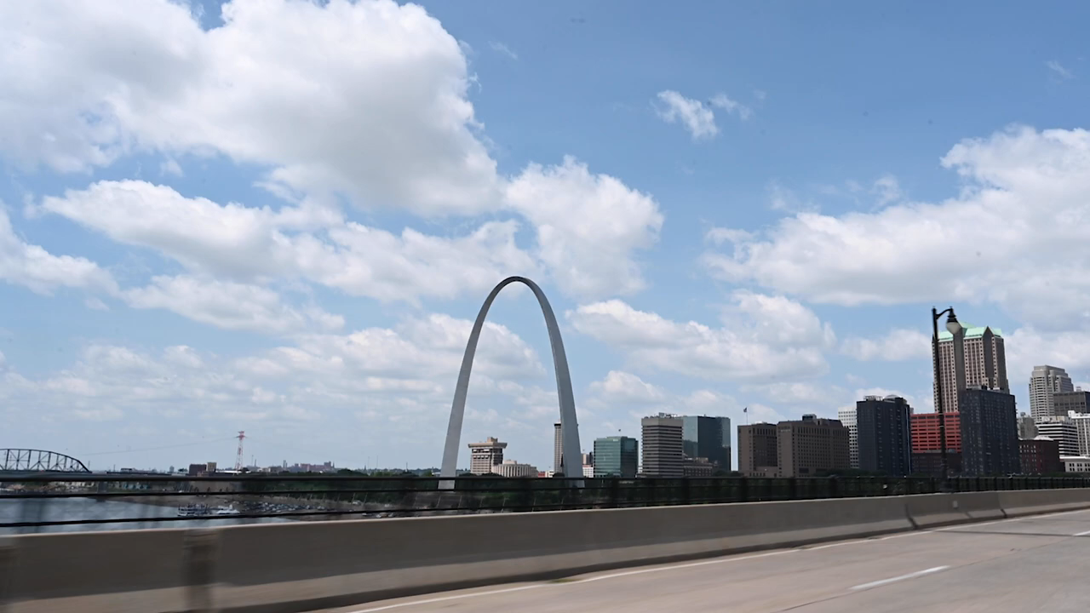
CC-TF St. Louis Video

